Slide 1
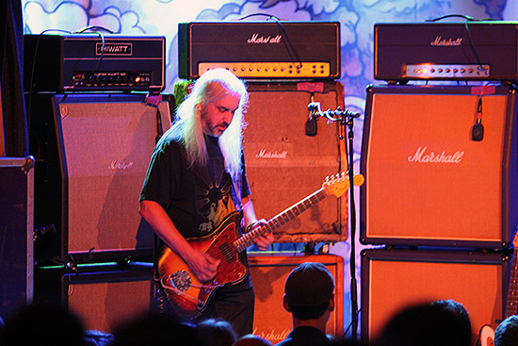
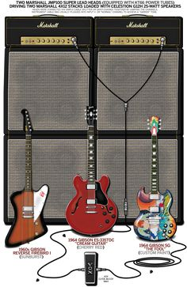
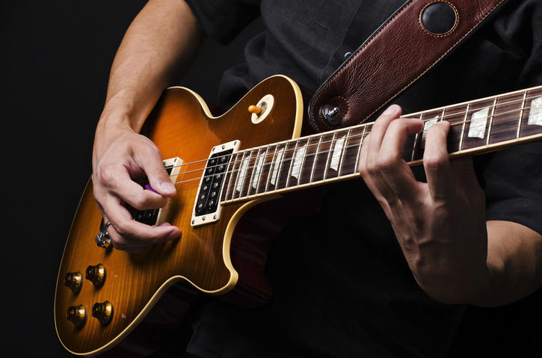
Midterm Proposal: Rigipedia
By David Verghese

Slide 2
Concept
I plan on creating a database that details what types of equipment (or “rigs”) my favorite guitarists have used on their albums. This would include the types of guitars, guitar picks, effect pedals, guitar amplifiers, guitar strings, etc. that they used.
Right: Example of a guitarist’s “Rig”

Slide 3
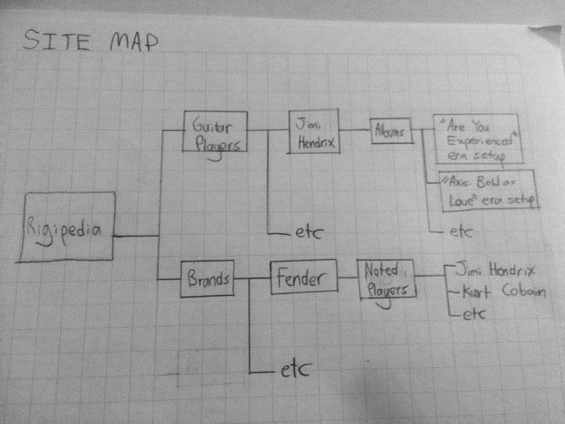
Site Map:

Slide 4
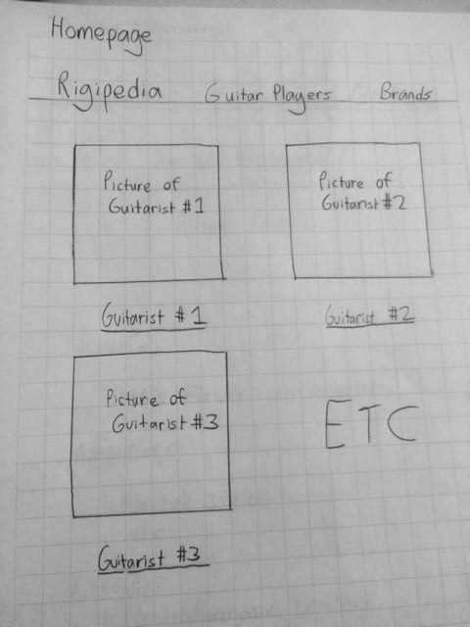
Wireframes: Homepage/ Guitar Players

Slide 5
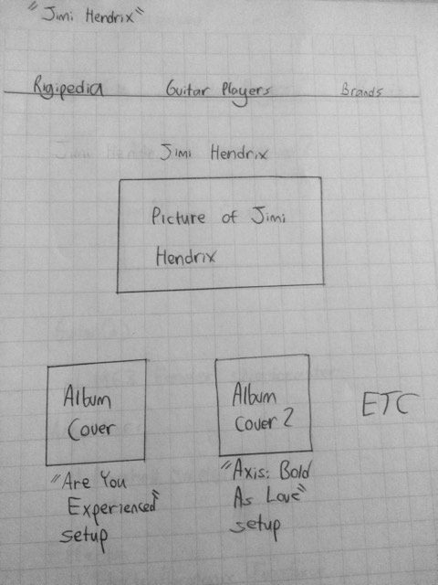
Wireframes: Jimi Hendrix

Slide 6
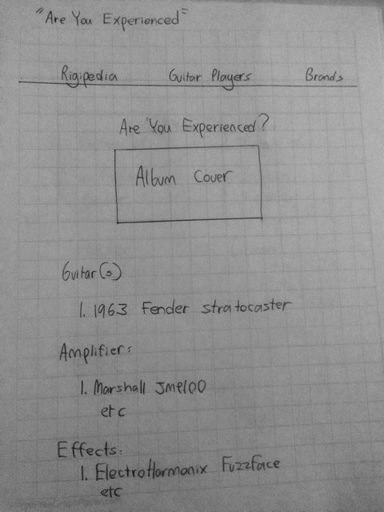
Wireframes: “Are You Experienced” Equipment
These pages could have sound files of songs to illustrate how the equipment sounds.

Slide 7
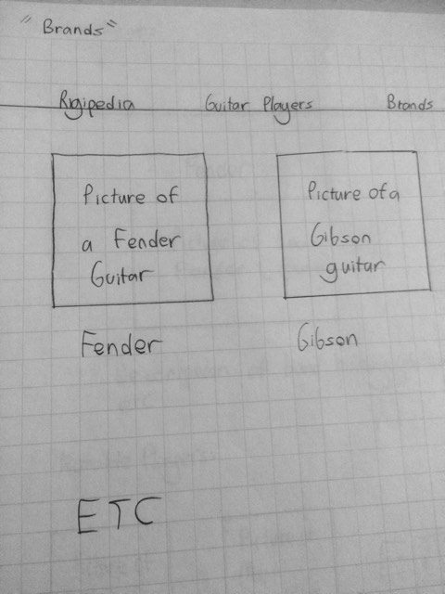
Wireframes: Brands

Slide 8
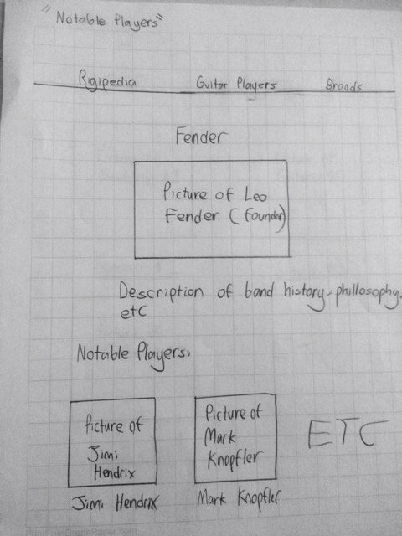
Wireframes: Notable Players

Slide 9
Existing Websites
There are lots of existing websites dedicated to listing the years used by musicians.
For example:
https://www.guitar.com/rigs
http://equipboard.com/pros/dave-grohl
http://www.whereseric.com/the-vault/guitars-amps-and-related-equipment/eric-claptons-guitar-amp-and-equipment-set-historical

Slide 10
Concepts I have learned that will help me build my site:
Search Bar
Inline block
Using divs
links (to other parts in the site, and other sites).

Slide 11
Concepts I still need to learn:
How to attach sound files
Creating a way to let you search the website.
Attaching tags, that can allow you to further categorize the entries
navigating in and out of different levels of a site.

